Slide 1

Semiconductor Diodes
Presented by
Md. Feroz Ali
Assistant Professor
Department of Electrical and Electronic Engineering (EEE)
Pabna University of Science and Technology (PUST)

Slide 2
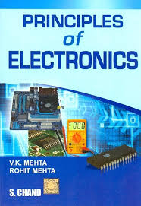
Book References

Slide 3
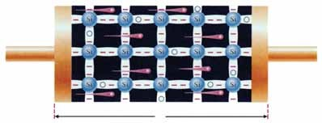
Electronics
The branch of engineering which deals with current conduction through a vacuum or gas or semiconductor is known as electronics.
The word electronics derives its name from electron present in all materials.
Importance:
Rectification
Amplification
Control
Generation
Conversion of light into electricity
Conversion of electricity into light
Fig. 1 Current conduction through semiconductor

Slide 4
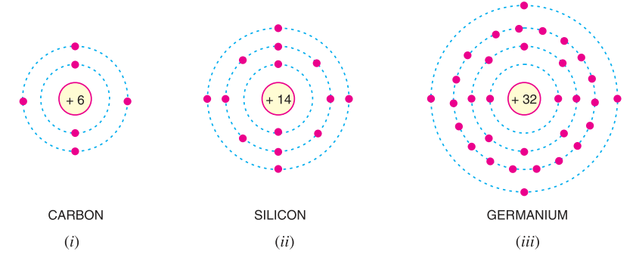
Valence Electrons
The electrons in the outermost orbit of an atom are known as valence electrons.

Slide 5
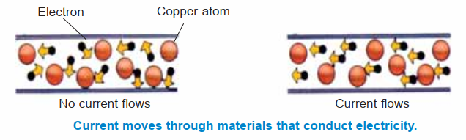
Free Electrons
The valence electrons which are very loosely attached to the nucleus are known as free electrons.

Slide 6
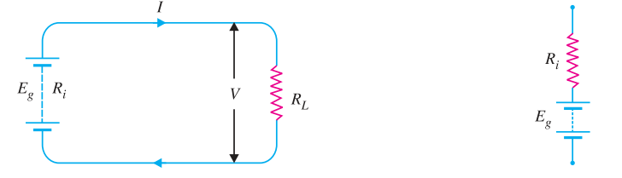
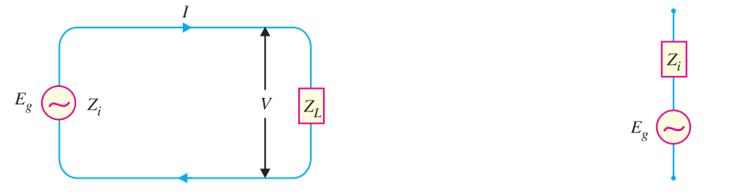
Voltage Source
Any device that produces voltage output continuously is known as a voltage source.
There are two types of voltage sources:
Direct voltage source
Alternating voltage source.
DC Voltage Source
AC Voltage Source

Slide 7
Electron Emission
The liberation of electrons from the surface of a substance is known as electron emission.
Types of Electron Emission:
Thermionic emission: The process of electron emission from a metal surface by supplying thermal energy to it is known as thermionic emission.
Field emission: The process of electron emission by the application of strong electric field at the surface of a metal is known as field emission.
Photo-electric emission: Electron emission from a metallic surface by the application of light is known as photo electric emission.
Secondary emission: Electron emission from a metallic surface by the bombardment of high-speed electrons or other particles is known as secondary emission.

Slide 8
Gas-Filled Tubes
A gas-filled tube is essentially a vacuum tube having a small amount of some inert gas at low pressure.
They may be classified into two types namely; cold-cathode type and hot-cathode type:
Cold-cathode type
Hot-cathode type

Slide 9
Gas-Filled Tubes (Applications)
Gas-filled tubes have various applications across different fields. Some common applications include:
Lighting: Gas-filled tubes such as neon lights and fluorescent tubes are used for illumination in signs, displays, and indoor lighting fixtures.
Voltage Regulation: Gas discharge tubes can be used in surge protectors and voltage regulators to protect electronic devices from power surges and transient voltages.
Communication: Gas-filled tubes like thyratrons and krytrons are used in high-speed switching applications in telecommunications and radar systems.
Gas Lasers: Gas-filled tubes serve as the active medium in gas lasers, which are used in various applications such as cutting, welding, medical procedures, and scientific research.
Particle Detectors: Gas-filled tubes are utilized in particle detectors for experimental physics research and in medical imaging devices like positron emission tomography (PET) scanners.
Ignition Systems: Gas discharge tubes are used in ignition systems for gas-powered equipment such as gas stoves, water heaters, and gas-powered vehicles.
These are just a few examples, and there are many other specialized applications for gas-filled tubes depending on their specific properties and characteristics.

Slide 10
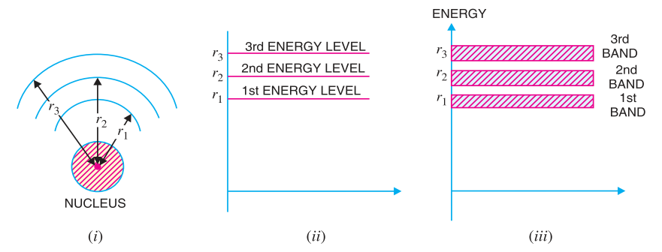
Energy Bands
The range of energies possessed by an electron in a solid is known as energy band.

Slide 11
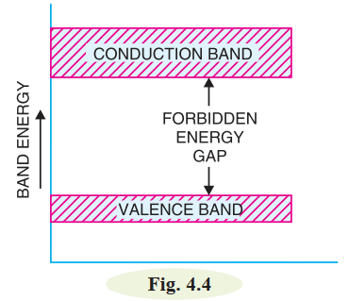
Energy Bands
The range of energies (i.e. band) possessed by valence electrons is known as valence band.
The range of energies (i.e. band) possessed by conduction band electrons is known as conduction band.
The separation between conduction band and valence band on the energy level diagram is known as forbidden energy gap.

Slide 12
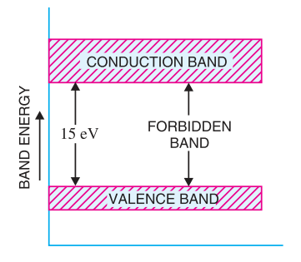
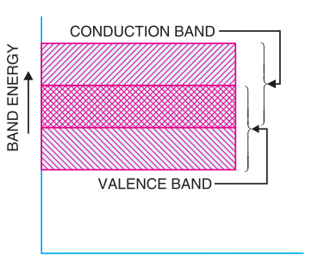
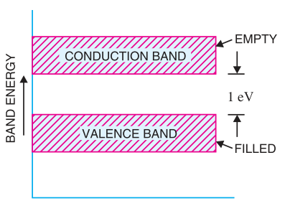
Energy Bands
Insulators
Conductor
Semiconductor

Slide 13
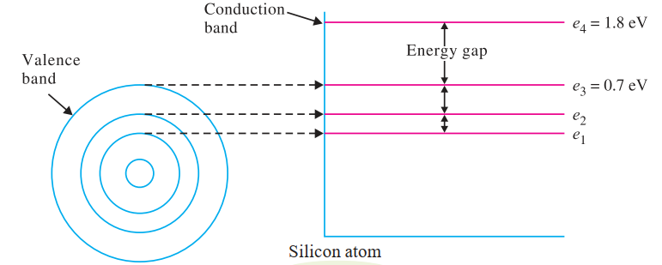
Energy Bands
For example, the valence band is shown to have an energy level of 0.7 eV. The conduction band is shown to have an energy level of 1.8 eV. Thus for an electron to jump from the valence band to the conduction band, an energy = 1.8 – 0.7 = 1.1 eV must be supplied.

Slide 14
Work Function
In physics, the work function refers to the minimum amount of energy required to remove an electron from the surface of a material and move it to a point just outside the material. It is typically denoted by the symbol Φ (phi) and is measured in electron volts (eV) or joules.
The work function of silicon, typically denoted by the symbol Φ, is approximately 4.85 electron volts (eV) at room temperature.

Slide 15
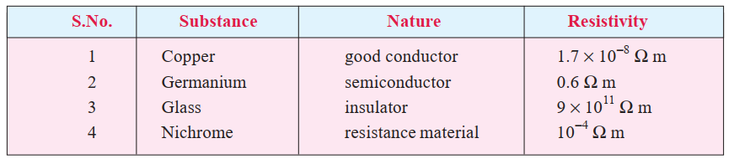
Semiconductor Physics
A semiconductor is a substance which has resistivity (${10}^{−4}$ to 0.5 Ω m) in between conductors and insulators e.g. germanium, silicon, selenium, carbon etc.

Slide 16
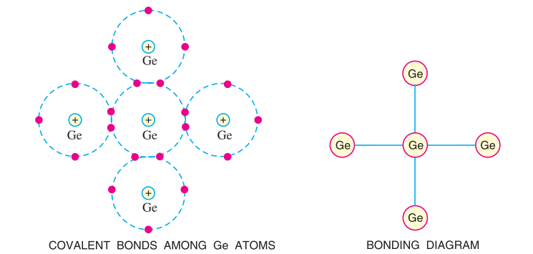
Semiconductor Physics
Bonds in Semiconductors (germanium atom):

Slide 17
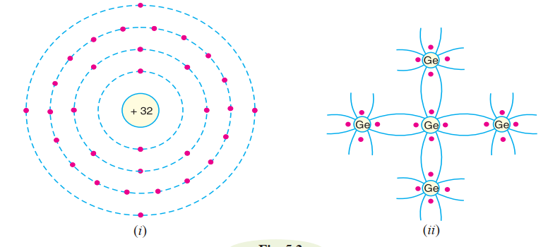
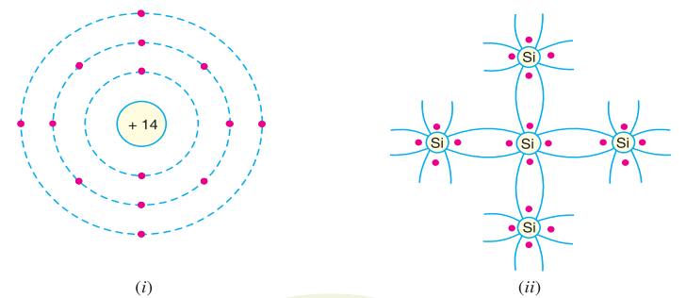
Semiconductor Physics
Commonly Used Semiconductors:

Slide 18
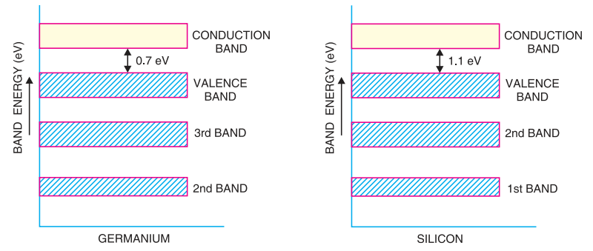
Semiconductor Physics
Energy Band Description of Semiconductors:

Slide 19
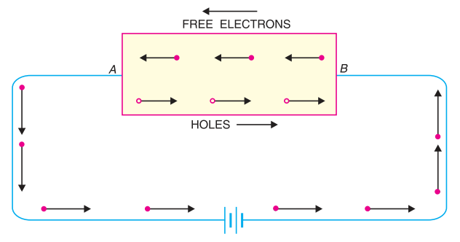
Semiconductor Physics
Intrinsic Semiconductor: A semiconductor in an extremely pure form is known as an intrinsic semiconductor.

Slide 20
Semiconductor Physics
Extrinsic Semiconductor: The intrinsic semiconductor has little current conduction capability at room temperature. To be useful in electronic devices, the pure semiconductor must be altered so as to significantly increase its conducting properties. This is achieved by adding a small amount of suitable impurity to a semiconductor. It is then called impurity or extrinsic semiconductor. The process of adding impurities to a semiconductor is known as doping.
Depending upon the type of impurity added, extrinsic semiconductors are classified into:
(i) n-type semiconductor
(ii) p-type semiconductor

Slide 21
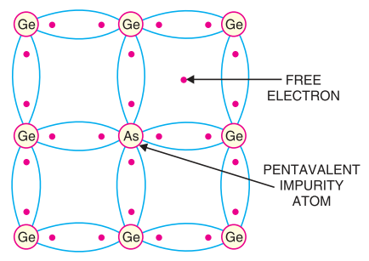
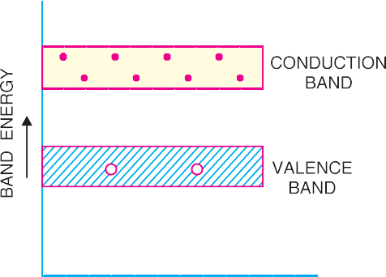
Semiconductor Physics
n-type Semiconductor: When a small amount of pentavalent impurity (arsenic, antimony etc.) is added to a pure semiconductor, it is known as n-type semiconductor. Such impurities which produce n-type semiconductor are known as donor impurities because they donate or provide free electrons to the semiconductor crystal.

Slide 22
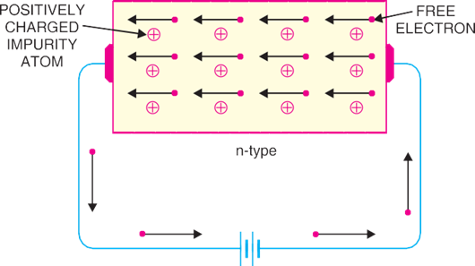
Semiconductor Physics
n-type conductivity. The current conduction in an n-type semiconductor is predominantly by free electrons i.e. negative charges and is called n-type or electron type conductivity.

Slide 23
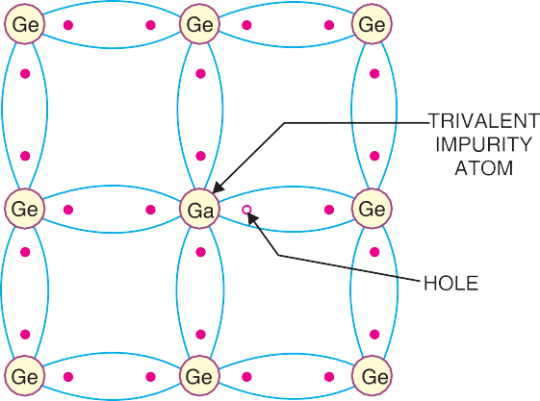
Semiconductor Physics
p-type Semiconductor: When a small amount of trivalent impurity (gallium, indium etc.) is added to a pure semiconductor, it is called p-type semiconductor. Such impurities which produce p-type semiconductor are known as acceptor impurities because the holes created can accept the electrons.

Slide 24
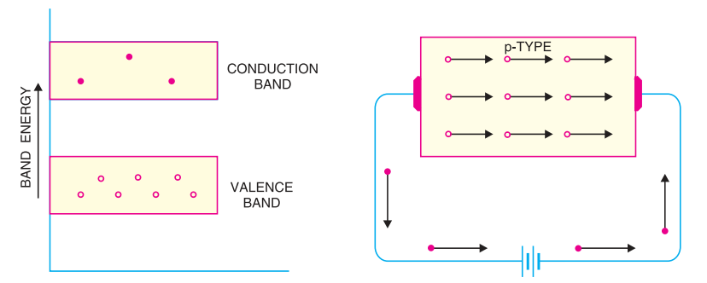
Semiconductor Physics
p-type conductivity: The current conduction in p-type semiconductor is predominantly by holes i.e. positive charges and is called p-type or hole-type conductivity.

Slide 25
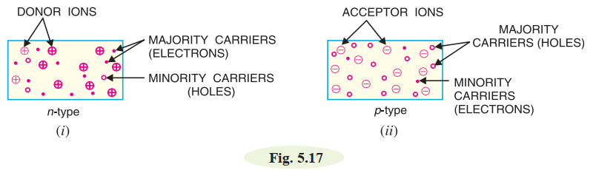
Semiconductor Physics
Majority and Minority Carriers: An n-type material has its share of electron-hole pairs (released due to breaking of bonds at room temperature) but in addition has a much larger quantity of free electrons due to the effect of impurity. These impurity-caused free electrons are not associated with holes. Consequently, an n-type material has a large number of free electrons and a small number of holes as shown in Fig. 5.17 (i). The free electrons in this case are considered majority carriers — since the majority portion of current in n-type material is by the flow of free electrons — and the holes are the minority carriers.
Similarly, in a p-type material, holes outnumber the free electrons as shown in Fig. 5.17 (ii). Therefore, holes are the majority carriers and free electrons are the minority carriers.

Slide 26
Semiconductor Physics
To be continued……………

Slide 27
Thanks a lot

